Slide 1
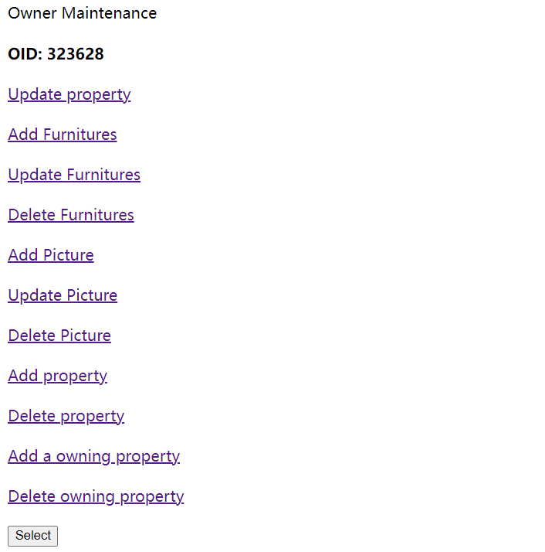
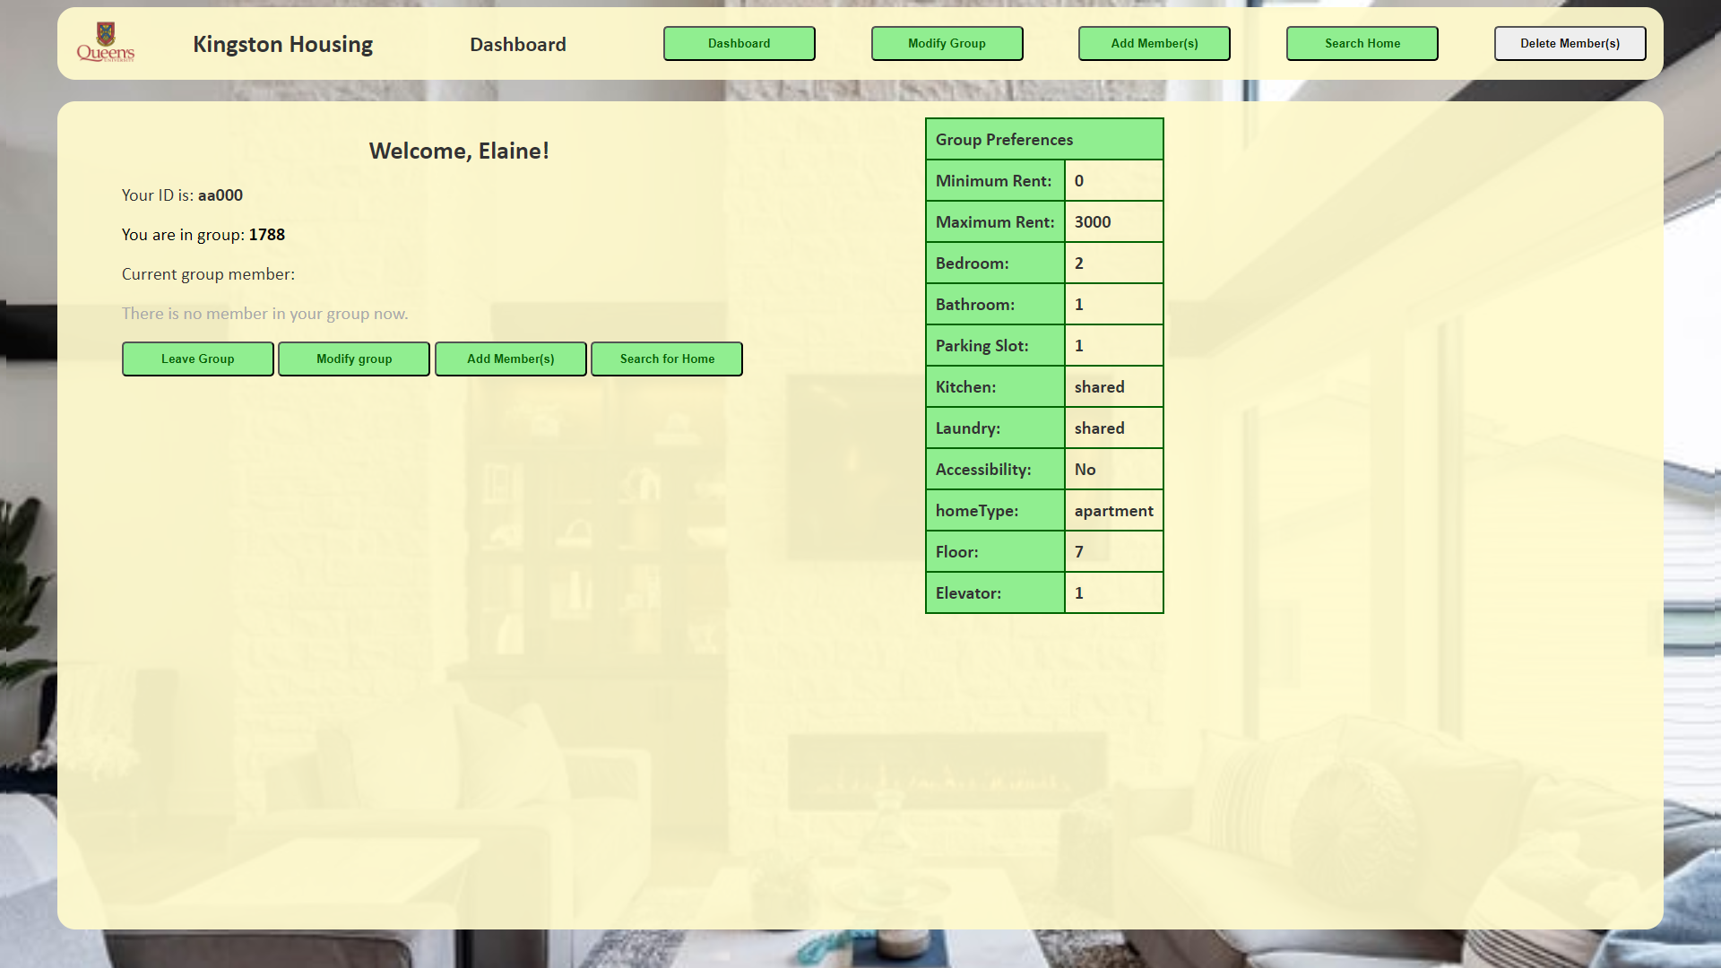
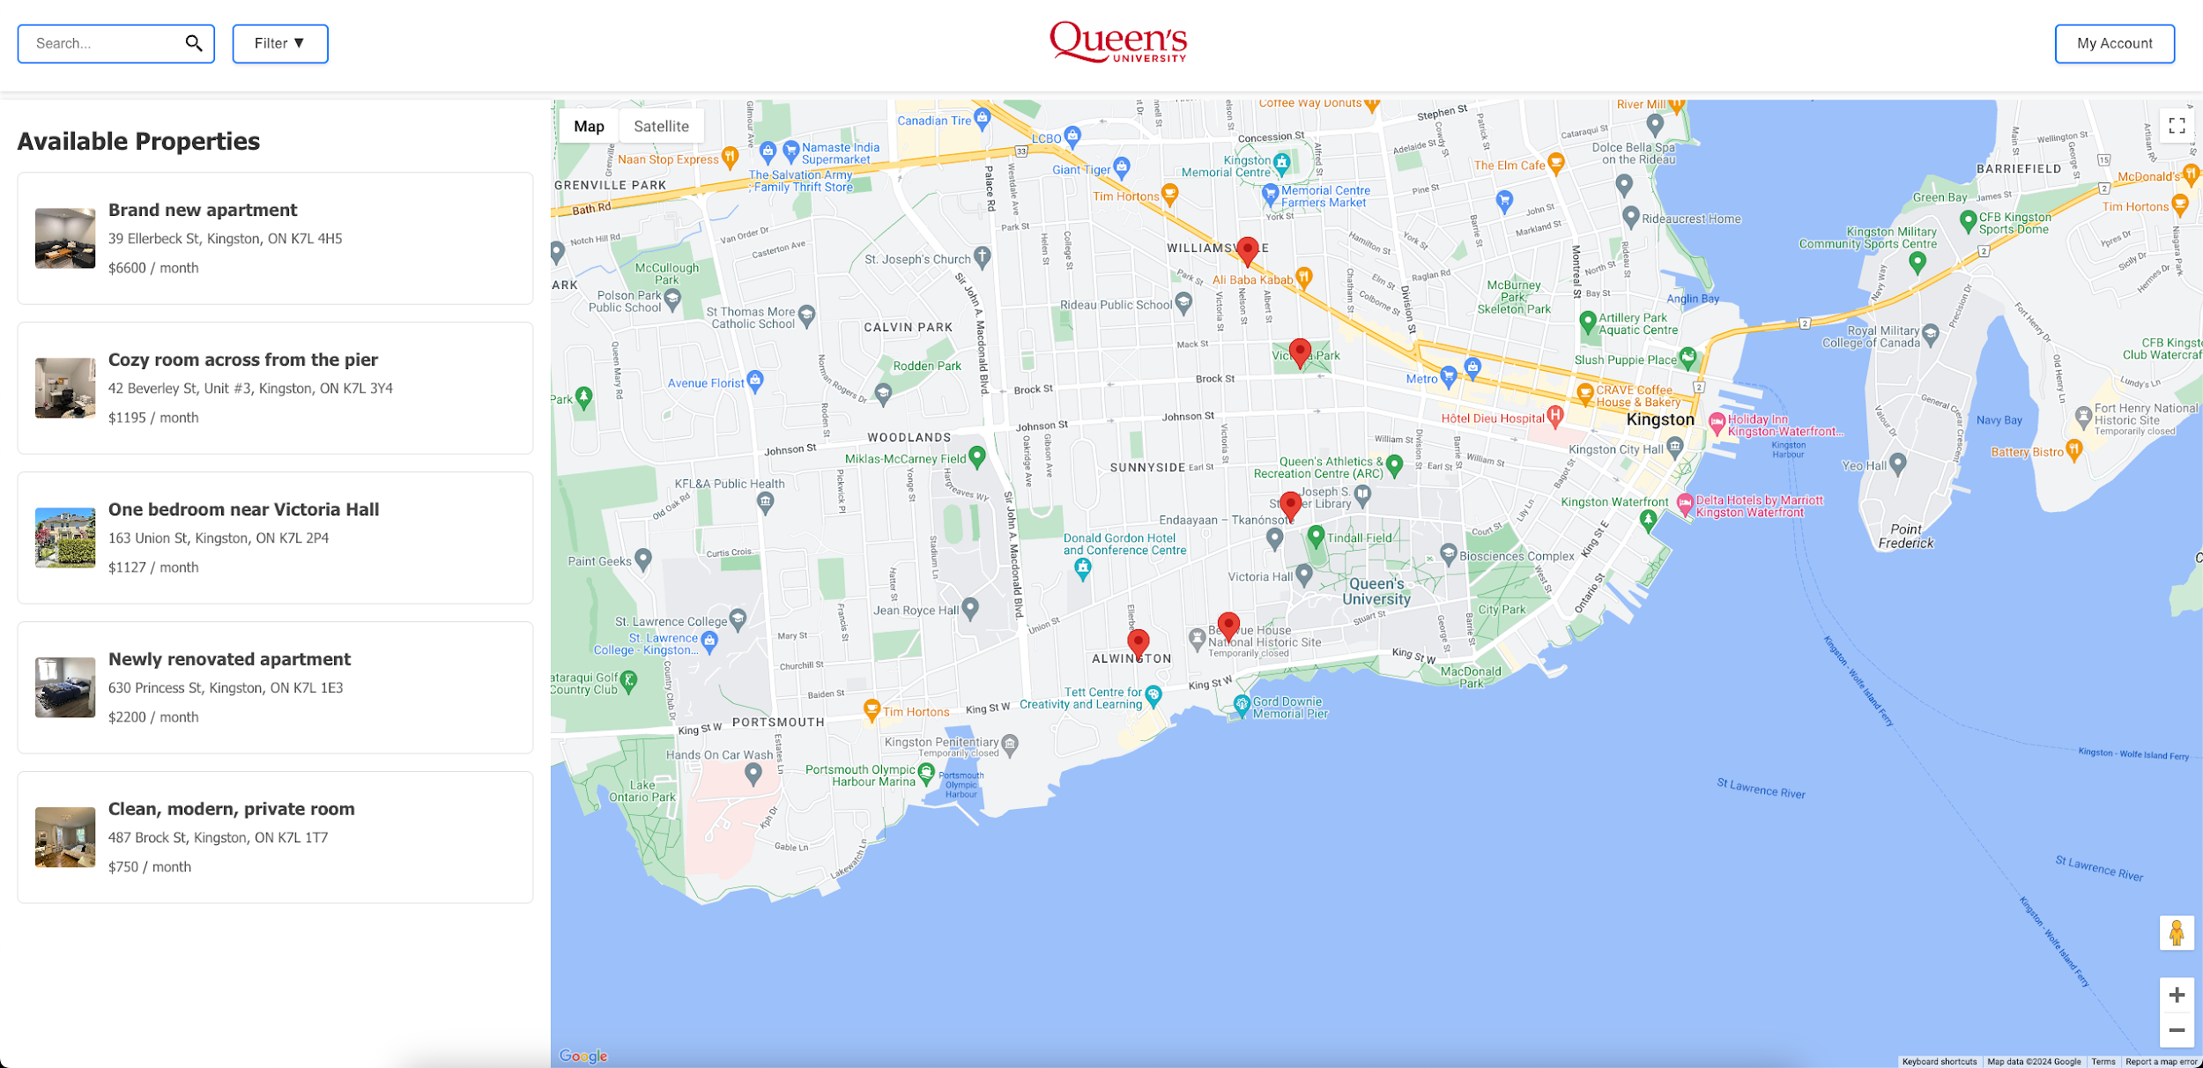

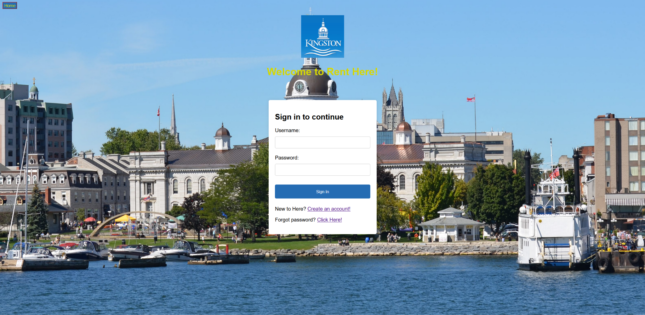
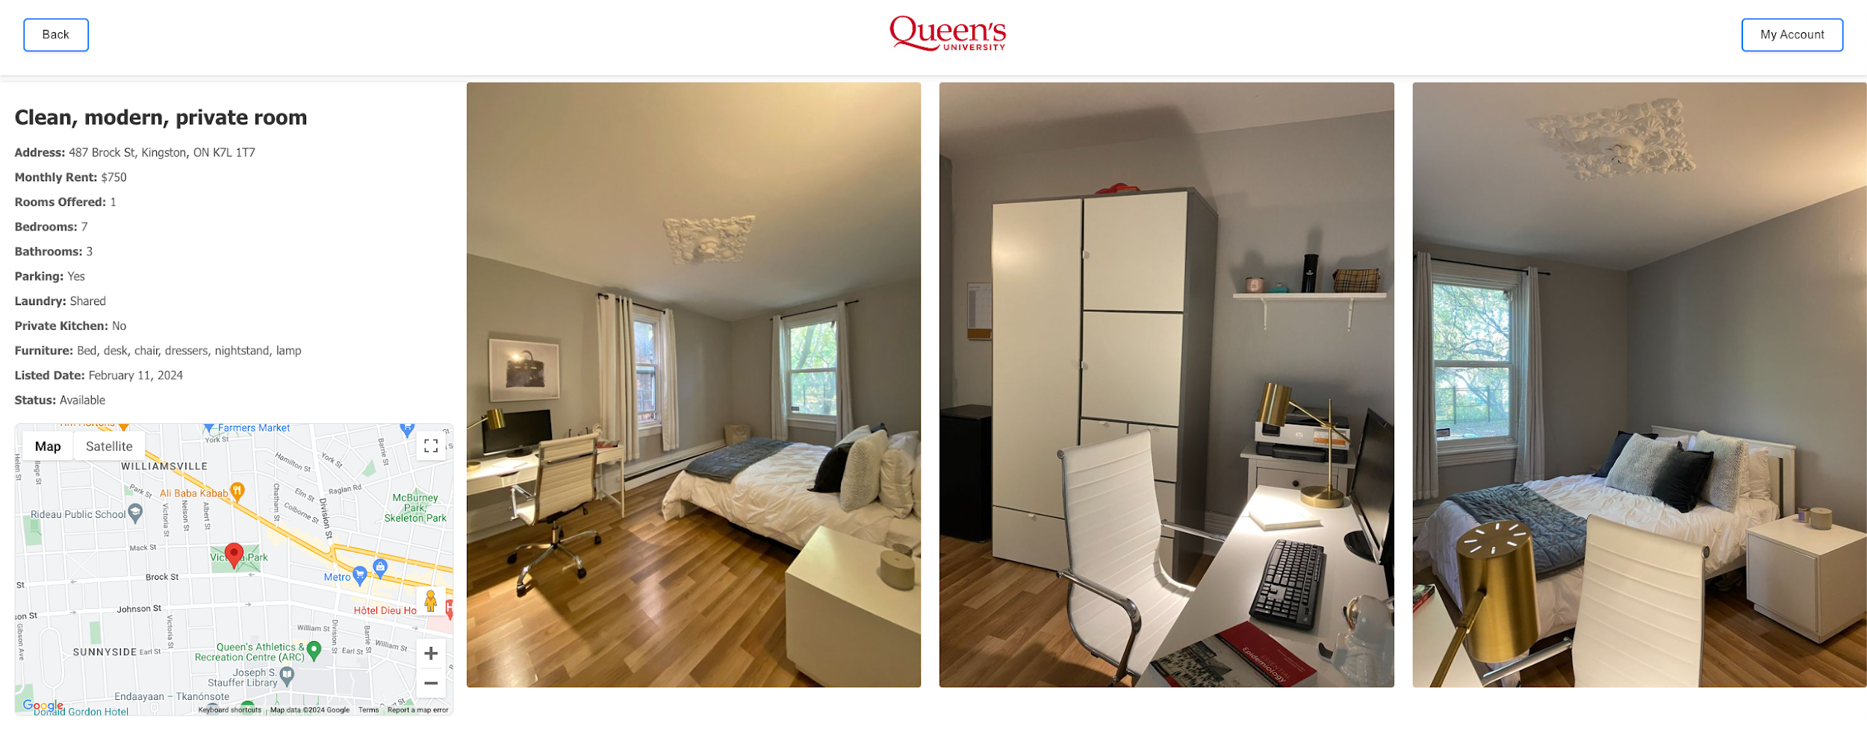

CITY OF KINGSTON STUDENT HOUSING PLATFORM
Sean Liang, Elaine Wu, Gavin Cheng, Kyle Ding
Prof. Wendy Powley
OUR PROBLEM
The search for student housing is notoriously stressful, time-consuming, and complex. Popular, existing platforms like Facebook Marketplace, while useful, often fall short in providing a convenient search experience for housing, making it difficult for students to find housing that meets their specific needs and preferences.
Our project addresses this issue by streamlining the housing search process through a user-friendly full-stack real estate application, designed specifically for Queen’s students. We transform the daunting task of finding student housing into a manageable, even enjoyable, process.
Interactive Map Integration:
By integrating the Google Maps, Google Places, and Google Geocoding APIs, we provide users with a visual representation of available properties, allowing them to explore different neighborhoods and understand the context of each listing in relation to their university, public transport, and local amenities.
Simplified Search Process:
We streamline the search experience with filters tailored to student needs, including price range, number of bedrooms, and lease terms. The autofill search results are biased towards landmarks and locations specific to the Queen’s Campus. This simplification reduces the time and effort required to find suitable housing.
Detailed Property Profiles:
Our application expands on each listing module with comprehensive property details, including a lightbox-style picture viewer. This ensures that students have all the information they need at their fingertips, allowing for more reliable decision-making without the need for extensive in-person viewings.
Sign In page:
Our login page focuses on user experience and not only provides easy access, but also provides registration and password reset capabilities. During the registration process, users can choose to register as a student or owner, streamlining the process to satisfy their specific needs. Owners can use a simple matching algorithm designed to pair them with a pool of students looking for properties that meet their criteria. This feature ensures a high level of satisfaction and efficiency for both parties. The figure of this page illustrate the user-friendly design and functional layout of our pages.
For Part three, the main purpose is for students’ experiences. They can leave the group, add or delete a member from their group, modify and search according to their group preferences. Thus, tables are generated according to the need with one table linking the students and the groups.
For the group part, students can use name and wildcards to search for their new group members. Multiple students are allowed to be added to or deleted from the group in one search. Once a group has no members in it (all members are deleted or left), the group ID will be cleared from the table for further use.
For the search function, students are allowed to choose the must feature, and return the properties which matches all their preferences and those only matches their must-needs.
Homepage
In Part Two of the Kingston Rental Property Management System (KRPM) project, we focus on the pivotal development of a comprehensive system designed for property owners to input information about their properties for potential tenants to search. This segment introduces a meticulously crafted database, anchored by an Entity-Relationship (ER) diagram, to manage complex relationships between property owners, tenants, and rental units. Key advancements include dynamic property management functionalities, enhanced user interactions through real-time updates, and sophisticated image and information management capabilities. These efforts aim to streamline the rental process, ensuring both property owners and tenants benefit from an intuitive, efficient, and user-friendly platform.
Admin Dashboard Page
OUR SOLUTION
Our platform overhauls the student housing hunting experience by offering a visually appealing UI combined with powerful search tools and an interactive map. Here's how we make the difference:
Admin Dashboard:
The admin dashboard offers five key functions for easy navigation and user account management, including creation, editing, and deletion. A standout feature is the database backup, ensuring data security and system reliability. The other three management features enable administrators to efficiently handle different types of information through intuitive interfaces and tables, including data obtained from our database.
Both pages were developed utilizing HTML, CSS, and PHP, where HTML and CSS enhance the aesthetics and user-friendliness of our pages. Simultaneously, PHP streamlines database interactions, making our system more efficient and responsive.
Property View
Sign In Page.

